Slide 1
Two Datasets And Possible Applications
Zheng Lu (computer engineering)
zlu12@vols.utk.edu

Slide 2
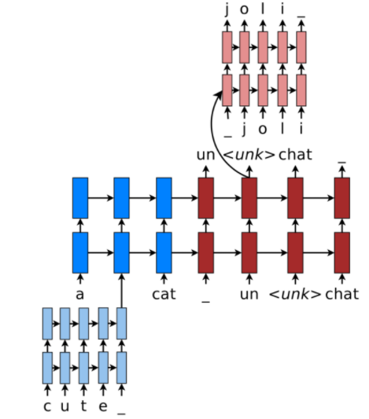
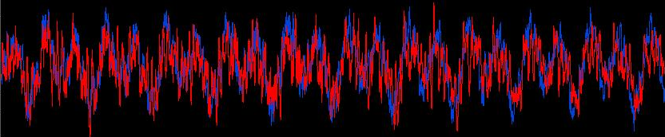
27000+ lossless Songs
Separate vocals from instruments.
How will Tylor Swift sing “Hello” by adele? (English to French)

Slide 3
2 months of tweets in 3 cities
Photo descriptions
Photos
Users
Locations
Photos are sort of labeled by the tweets.

